Slide 1
12.3 The Kernel Trick

Slide 2
This crucial issue, of not being able to effectively store and compute with high dimensional fixed-shape feature transformations, motivates notion of *kernelization*.
Kernelization not only allows us to avoid this scaling problem, but also provides a way of generating new fixed-shape features defined solely through such a kernelized representation.

Slide 3
A useful fact from the fundamental theorem of linear algebra

Slide 4



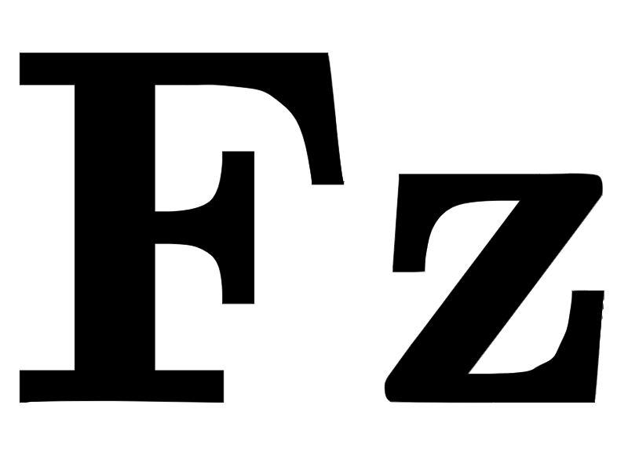

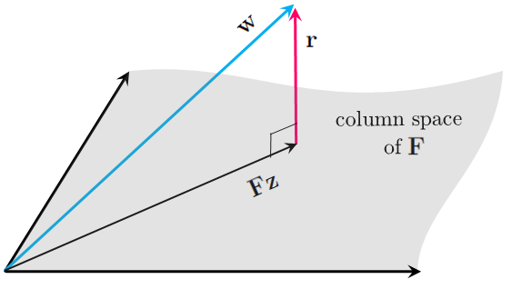
Any vector in an M-dimensional space can be decomposed over the column space of a given matrix , as
The vector belongs in the subspace determined by the columns of while is orthogonal to this subspace.

Slide 5
Kernelizing machine learning cost functions

Slide 6
Example: Kernelizing regression via the Least Squares cost

Slide 7
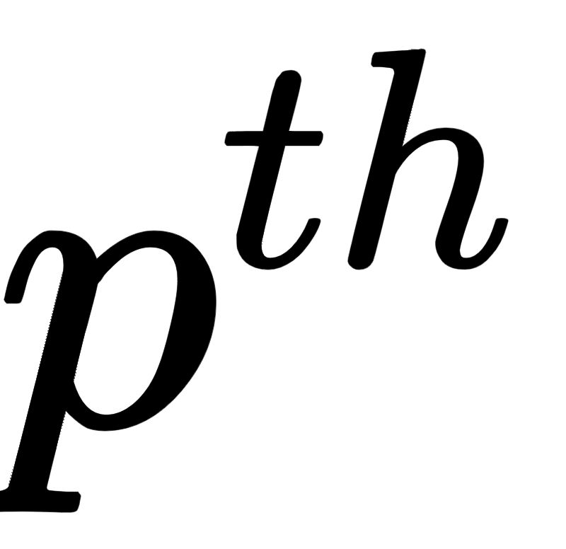
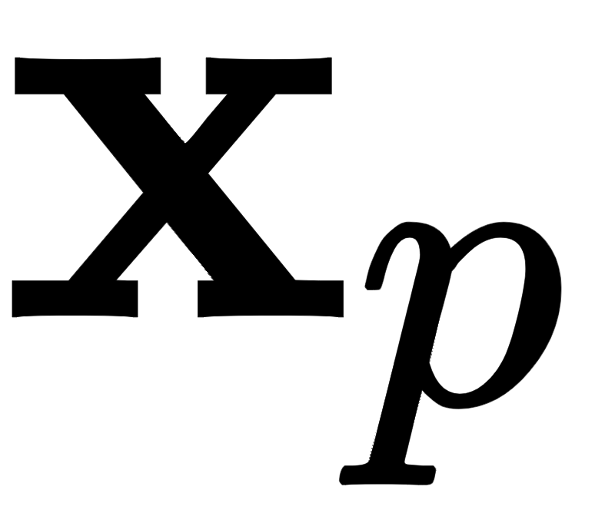
Suppose we want to perform a generic nonlinear regression using B units and the corresponding model evaluated at the input

Slide 8
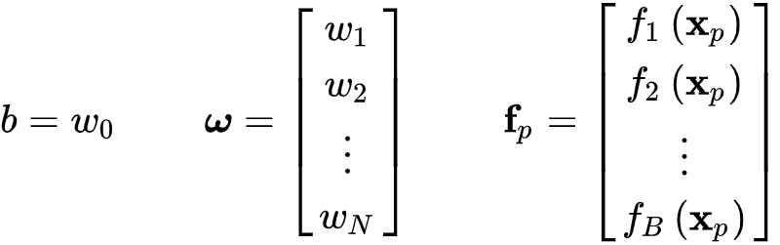
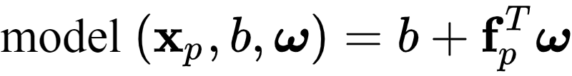
Using the compact notation
we can write our model more compactly - exposing the features apart from our bias - as

Slide 9

In this notation our Least Squares cost for regression takes the form

Slide 10

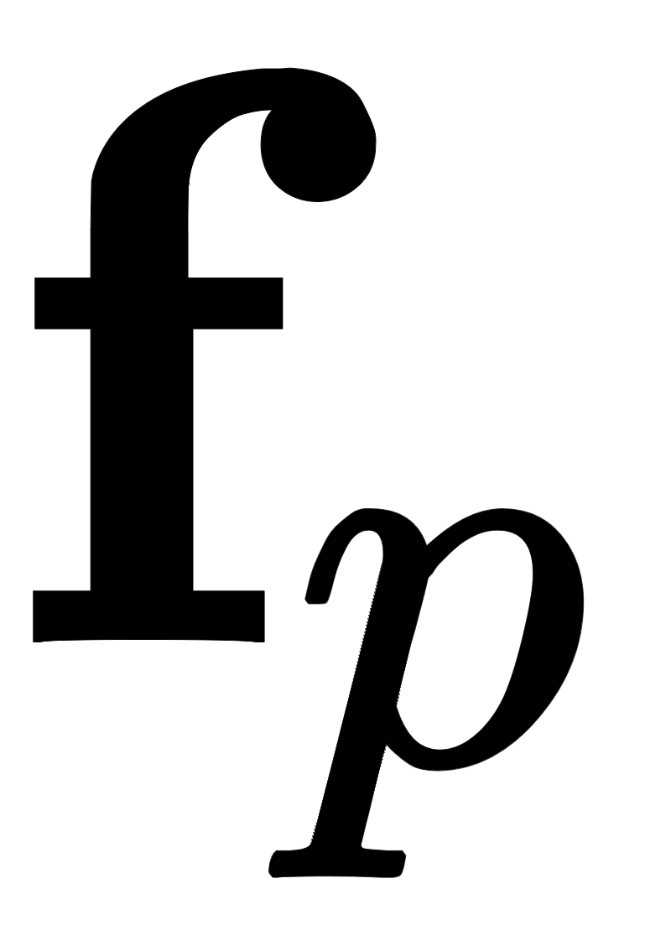

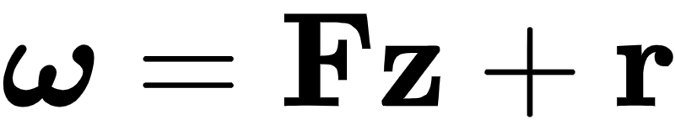
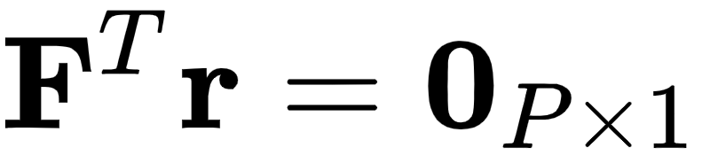
Denote by the matrix formed by stacking the vectors column-wise. Now, employing the fundamental theorem of linear algebra discussed above we may write here as
where satisfies

Slide 11
Plugging this representation of back into the cost function then gives

Slide 12


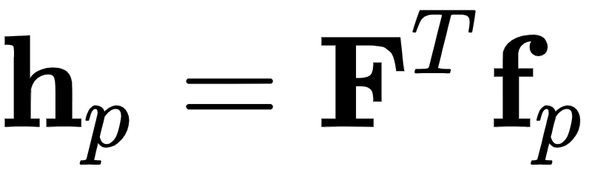
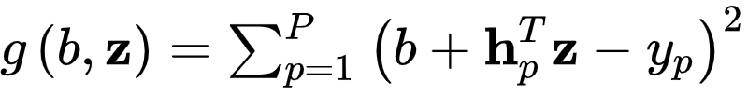
Finally, denoting the symmetric kernel matrix (and where is the column of this matrix), referred to as a kernel matrix or just the kernel, our original cost function becomes equivalently

Slide 13
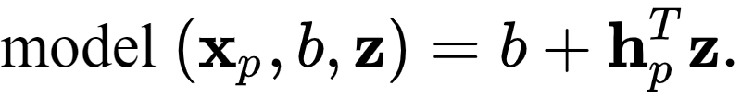
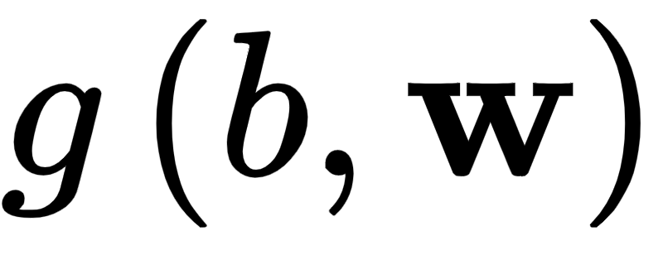
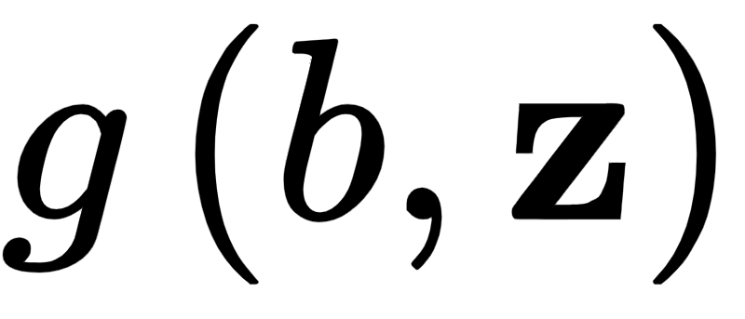
Our corresponding model evaluated at the input now takes the form
Note that we have changed the arguments of the cost function from to due to our substitution of .

Slide 14
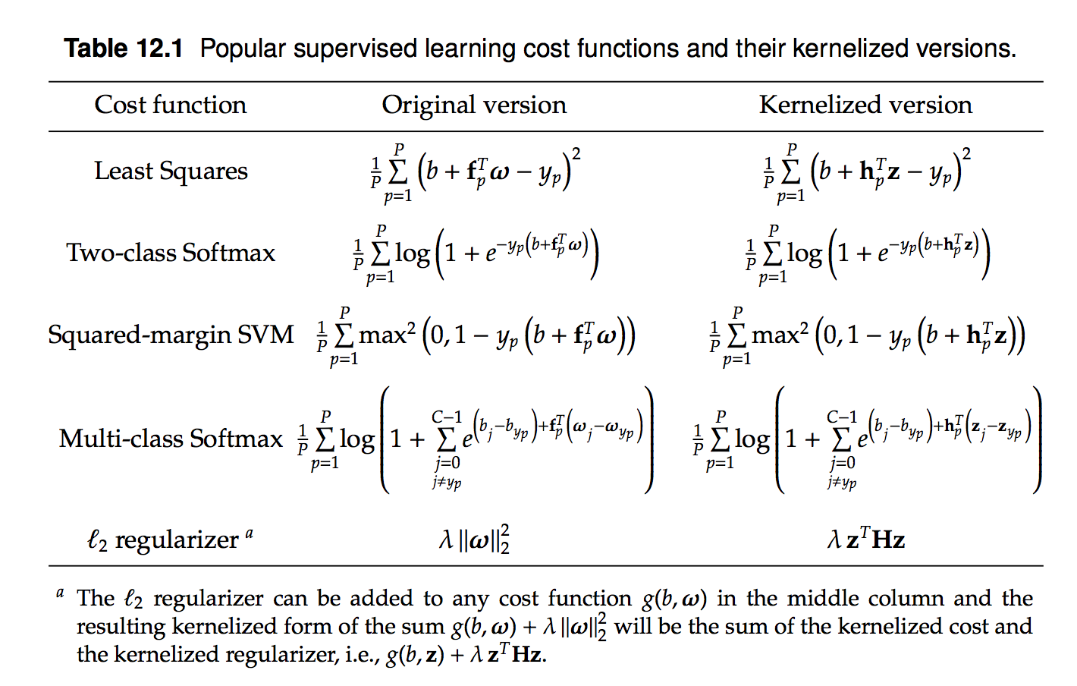
Using the same sort of argument, we may kernelize many machine learning problems, summarized for convenience in the table below.

Slide 15
Popular kernels

Slide 16
The real value of kernelizing any machine learning cost is that the kernel matrix may be constructed *without* first building the matrix , as we will see through the examples below.

Slide 17
Example: The polynomial kernel

Slide 18
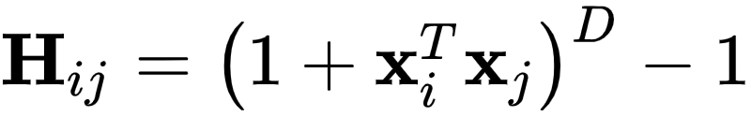
A polynomial kernel matrix can be defined entry-wise for general degree D and N dimensional input, as

Slide 19
Example: The Fourier kernel

Slide 20
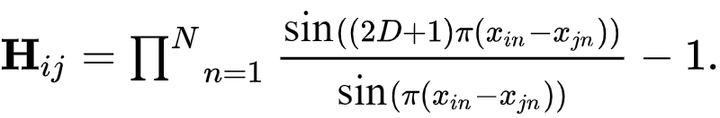
A Fourier kernel matrix can be defined entry-wise for general degree D and N dimensional input, as

Slide 21
Example: Kernel representation of radial basis function (RBF) features

Slide 22
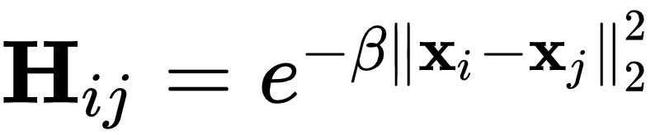
Another popular choice of kernel is the radial basis function (RBF) kernel which is typically defined explicitly as a kernel matrix over the input data as

Slide 23

The larger is set the higher the capacity of the RBF kernel becomes.
This is illustrated below via three examples: regression (top row), two-class (middle row), and multi-class (bottom row) classification.
In each case we use using the RBF kernel with three distinct settings of leading to underfitting, reasonable predictive behavior, and overfitting.

Slide 24
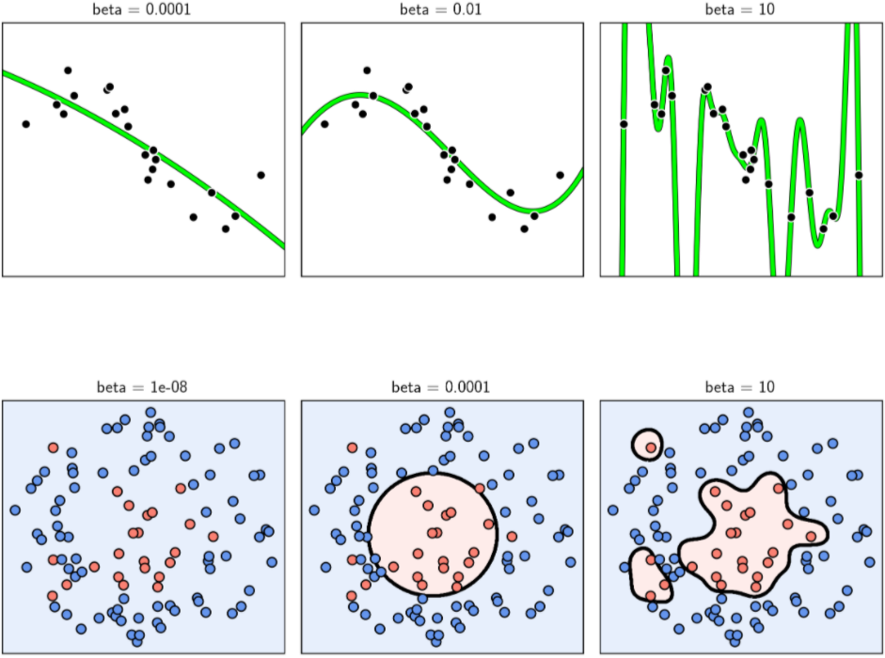

Slide 25
Making predictions with kernelized models

Slide 26
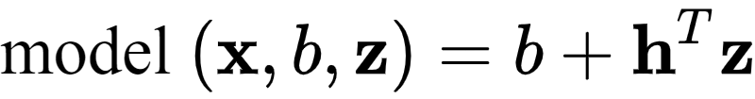
Assuming parameters b and have been fully tuned, the following model can be used for prediction purposes.

Slide 27


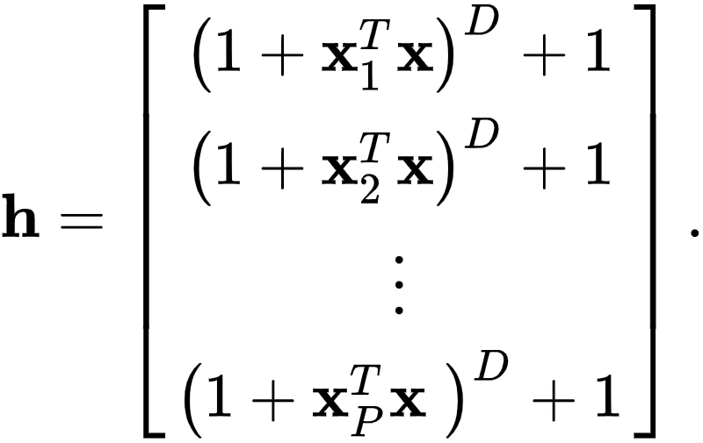
Here the kernelization of the generic input involves evaluation against *every point in the training set*. For instance, in the case of polynomials is given as

Slide 28
This necessity - to employ every training point in making predictions - is virtually unique to kernelized learners.

